Slide 1

IMPACT xApp: Interference Mitigation with Power Adaptation and Classification of Traffic
Students: Joshua Groen, Azuka Chiejina, Wan Liu, Divya Muruganandham,
Faculty: Dr. Vijay K. Shah and Dr. Kaushik Chowdhury

Slide 2
IMPACT xApp enables:
Up to 89% accuracy on traffic classification, the first step for traffic steering
Up to 99.6% accuracy on interference classification for URLLC traffic
Up to 7x energy savings for URLLC traffic
Up to 23x energy savings across all traffic types, based on channel conditions
Accuracy of IMPACT ML Models for demonstrated transition tests
Transition Test | Traffic Accuracy | Interference Accuracy
MMTC – URLLC | 88.9% | 77.5%
URLLC – MMTC | 79.6% | 79.3%
Interference OFF – ON, URLLC | 79.2% | 99.6%
Notes:
When URLLC traffic experiences interference, IMPACT uses LOWER MCS and MORE PRBs to provide similar throughput and 9 times lower average queue length than the baseline configuration. When there is NO interference, IMPACT reduces transmission gain by 40dB using 7 times less power during the test scenario than the baseline.
Max energy savings compared for trace with no interference compared to baseline system with no interference.
Baseline is default srsRAN/SCOPE configurations with same number of PRBs as IMPACT slice.

Slide 3


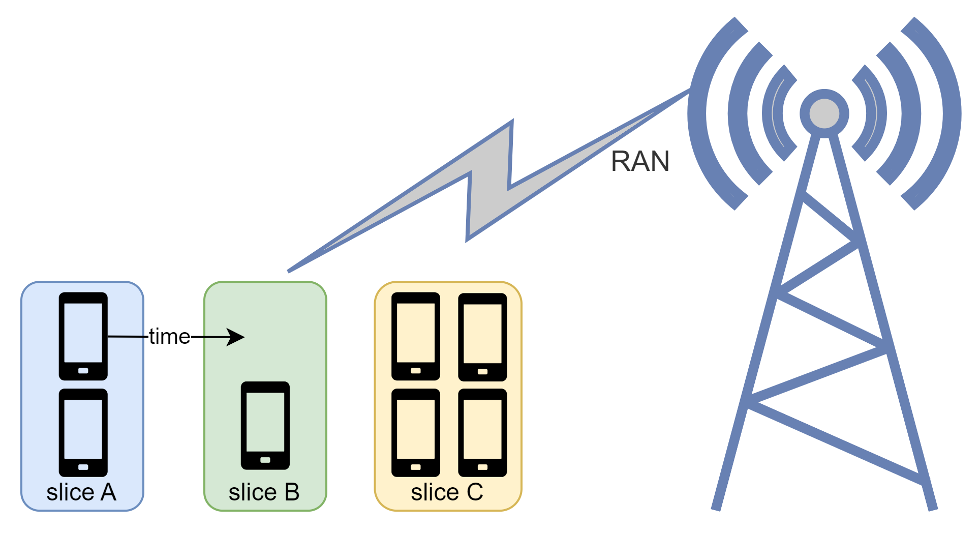
















Introduction
Identifying both the traffic class and interference is vital for enabling RAN control to achieve optimal traffic steering and energy savings.
Various traffic types exhibit distinct and frequently conflicting characteristics and requirements.
The growing demand on finite spectrum resources necessitates innovative interference detection and mitigation strategies.
eMBB
mMTC
URLLC
A. Chiejina, B. Kim, K. Chowdhury, and V. K. Shah, System-level Analysis of Adversarial Attacks and Defenses on Intelligence in O-RAN based Cellular Networks, in ACM WiSec 2024.
M. Belgiovine, J. Gu, J. Groen, U. Demir, and K. R. Chowdhury, “MEGATRON: Machine Learning in 5G with Analysis of Traffic in Open Radio Access Networks,” International Conference on Computing, Networking and Communications (ICNC), Feb. 2024.

Slide 4





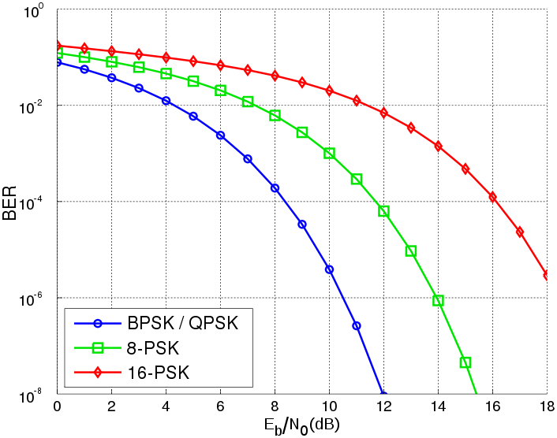





Overview
Identifying both the traffic class and interference is vital for enabling RAN control to achieve optimal traffic steering and energy savings.
Traffic Type
Core Network
URLLC
eMBB
mMTC
Interference
No
Interference
No
Interference
No
Yes
Yes
Yes
Short queues
High priority
Traffic shaping
Large queues
Normal priority
Traffic policing
Large queues
Normal priority
Traffic policing
Increase PRB
Adjust MCS and power
Reduce MCS and PRB
High RELIABILITY
High CAPACITY
Best Effort
Scheduling
PRB assignment
MCS
PRB assignment
MCS
Scheduling
MCS
PRB assignment
Scheduling
!
Splash, CC BY-SA 3.0, via Wikimedia Commons
Notes:
This is the first effort to jointly leverage traffic and interference classification information and perform traffic steering and energy savings using appropriate RAN control actions with an end-to-end implementation on the world’s largest hardware-in-the-loop emulator, the NSF Colosseum.
Power saving examples: Depending on channel conditions we can increase or decrease power or keep power constant and increase and decrease MCS. Additionally, granting more or less PRBs can maintain similar throughput for various MCS/ Power combinations.
Interference of this sort is only one example of the channel changing, but it is a good illustration of what IMPACT is capable of.

Slide 5
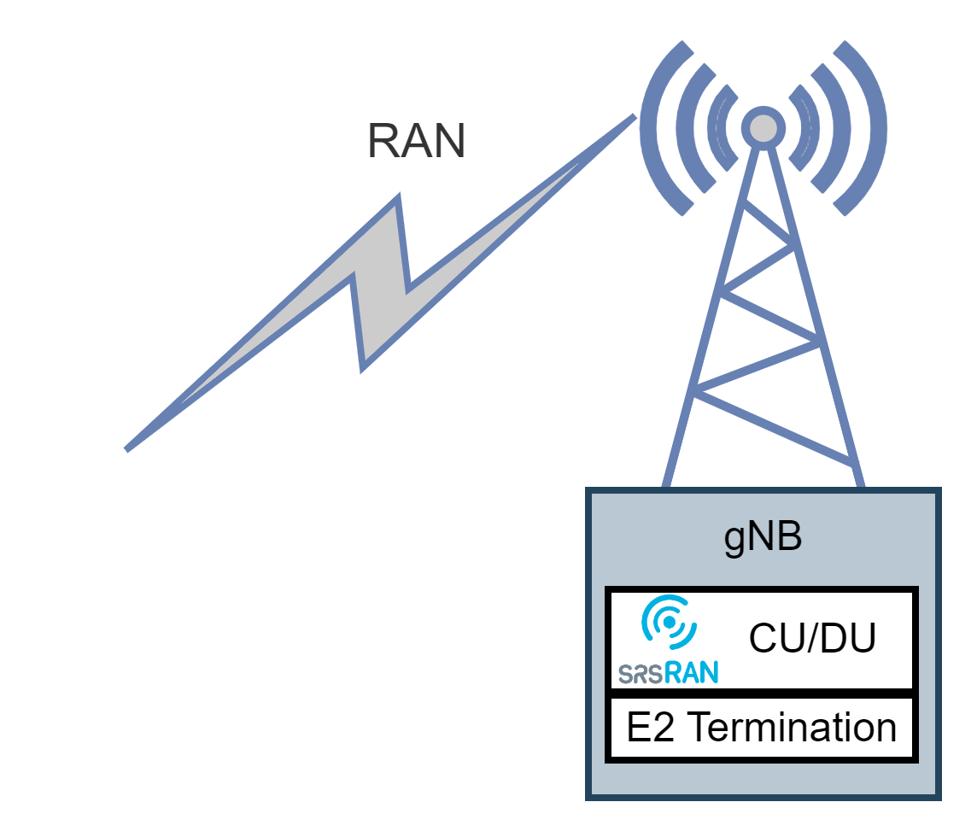
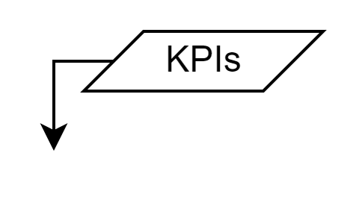
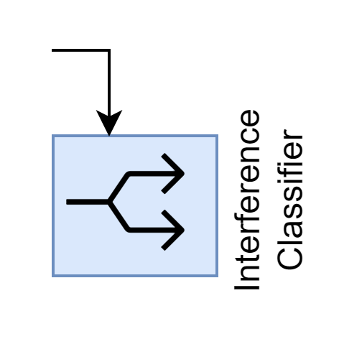
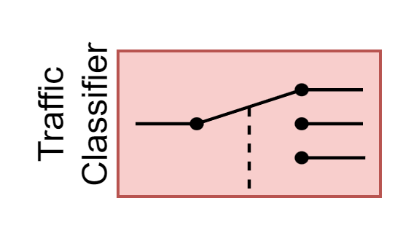
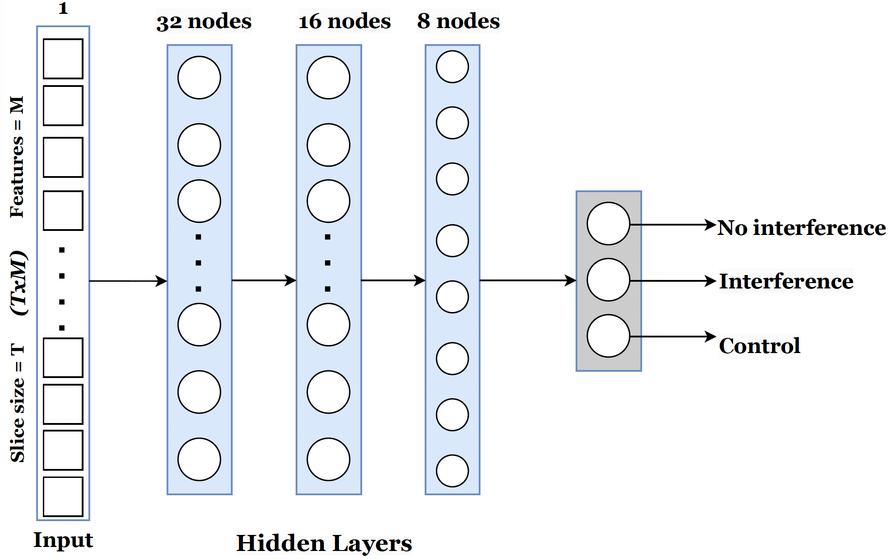
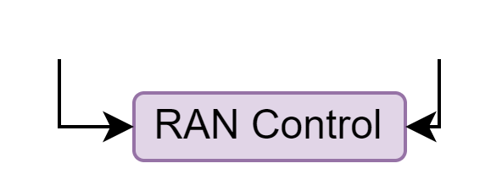
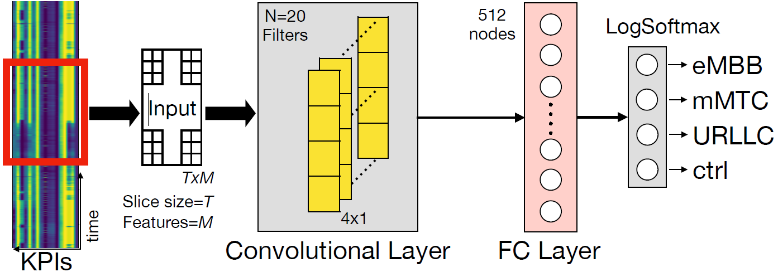

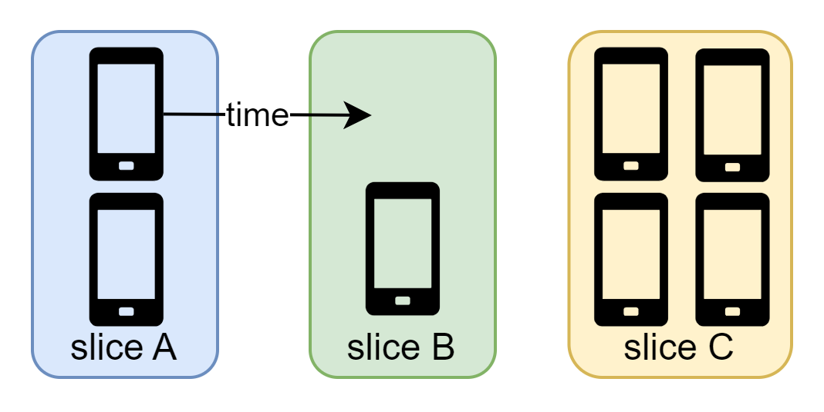
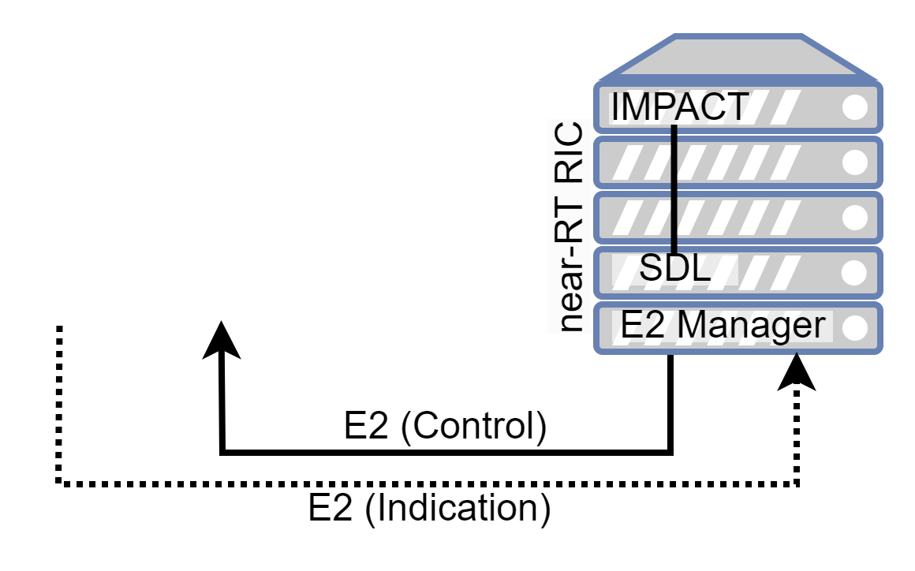

Overview
KPI | Explanation
dl_mcs | Downlink Modulation and Coding Scheme
dl_n_samples | Downlink number of samples transmitted since last time stamp
dl_buffer [bytes] | Downlink current queue length in bytes
tx_brate downlink [Mbps] | Downlink throughput in Mbps
tx_pkts downlink | Downlink number of packets transmitted since last timestamp
dl_cqi | Downlink Channel Quality Indicator
ul_mcs | Uplink Modulation and Coding Scheme
ul_n_samples | Uplink number of samples received since last time stamp
ul_buffer [bytes] | Uplink current queue length in bytes
rx_brate uplink [Mbps] | Uplink throughput in Mbps
rx_pkts uplink | Uplink number of packets received since last timestamp
rx_errors uplink (%) | Uplink error rate % during last period
ul_sinr | Uplink SINR
phr | UE Power HeadRoom
sum_requested_prbs | Total requested PRBs
sum_granted_prbs | Total granted PRBs
ul_turbo_iters | Uplink TurboCoder iterations
IMPACT xAPP
(I)
(II)
!
(I)
(II)
(III)
(III)
RAN Control
Slice Assignment
Scheduling
RB Allocation
MCS
Power
J. Groen, M. Belgiovine, U. Utku, B. Kim, and K. R. Chowdhury, “TRACTOR: Traffic Analysis and Classification Tool for Open RAN,” IEEE International Conference on Communications (ICC), June 2024.
Notes:
Our IMPACT (Interference Mitigation with Power Adaptation and Classification of Traffic) xApp, is illustrated here within the RIC (RAN Intelligent Controller). This xApp efficiently combines three key functional modules:
Network Traffic Classification Module: Based on Key Performance Indicators (KPIs) retrieved from the gNodeB, this module accurately classifies network traffic into three categories – (a) eMBB, (b) URLLC, and (c) mMTC. We use a convolutional neural network that uses a total of 17 KPI inputs to classify user traffic into one of four slices, i.e., eMBB, URLLC, mMTC, and control (ctrl). This fourth class consists of devices that are associated with the gNB but not actively transmitting or receiving. This traffic consists solely of association messages between the gNB and UE and no actual user plane traffic.
Interference Classification Module: Based on a subset (4) of the same KPIs, this model identifies whether the network is experiencing harmful interference or not. We use a deep neural network composed of three fully connected layers to identify if there is intentional interference in the uplink signal versus channel-induced signal outages.
RAN Control Module: Utilizing the RIC's RAN control capabilities, it optimizes network operations by making informed decisions, such as resource block allocation and scheduling policies tailored to meet traffic requirements. The holistic approach not only enhances network performance but also contributes to energy conservation.

Slide 6
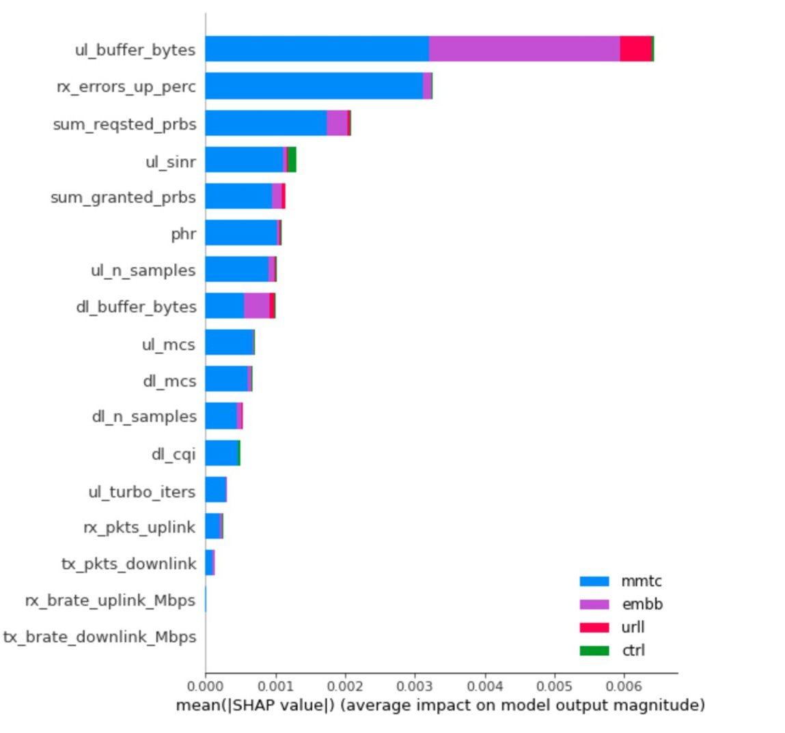
XAI for KPI Selection
Output
Model
Weighted average marginal contribution of each feature to the model
Feature 1
Feature 2
Explanation
Feature N
C. Tassie, B. Kim, J. Groen, M. Belgiovine and K. R. Chowdhury, “Leveraging Explainable AI for Reducing Queries of Performance Indicators in Open RAN,” IEEE International Conference on Communications (ICC), June 2024.

Slide 7








Spectrum Sensing CBRS band
Edge Cloud
gNB
ESC
Tier 1 - Radar
gNB
Medium Access Management
SAS
ESC
Tier 2 – Cellular communications
gNB
ESC
Tier 3
General Authorized Access (GAA)
gNB
ESC
ESC sensors are dedicated infrastructure deployed just for radar detection purposes
G. Reus-Muns, P. Upadhyaya, U. Demir, N. Stephenson, N. Soltani, V. K. Shah, K. R. Chowdhury, “SenseORAN: O-RAN based Radar Detection in the CBRS Band,” IEEE Journal on Selected Areas in Communications (JSAC), vol. 42, no. 2, August 2023.

Slide 8
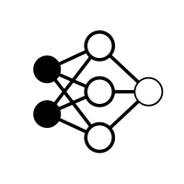

Spectrum Sensing CBRS band
3
Near-real-time RIC
Radar detection xApp
Radar detection
1
Generate spectrogram from I/Q samples
Spectrogram
Yolov3
2
Send spectrogram at the near-RT RIC (E2 interface)
E2 interface
4
2
gNB
gNB
3
Run radar detection xApp
O-CU
Spectrogram
I/Q
O-DU
Spectrogram
1
4
Update gNB configuration
O-RU
UE
Type-1 radar

Slide 9
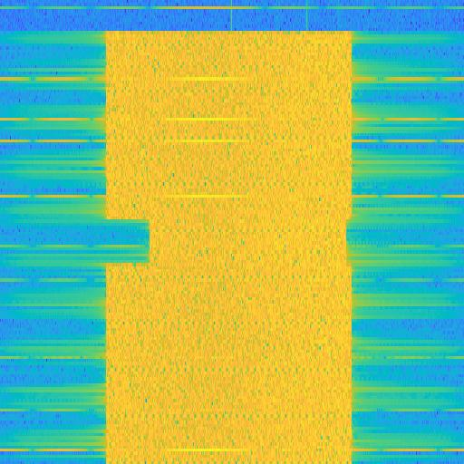
Spectrum Sensing CBRS band
Bounding box
Radar
+
YOLOv3
Input spectrogram
Radar bounding box
Radar detection
Total running time = 866ms

Slide 10
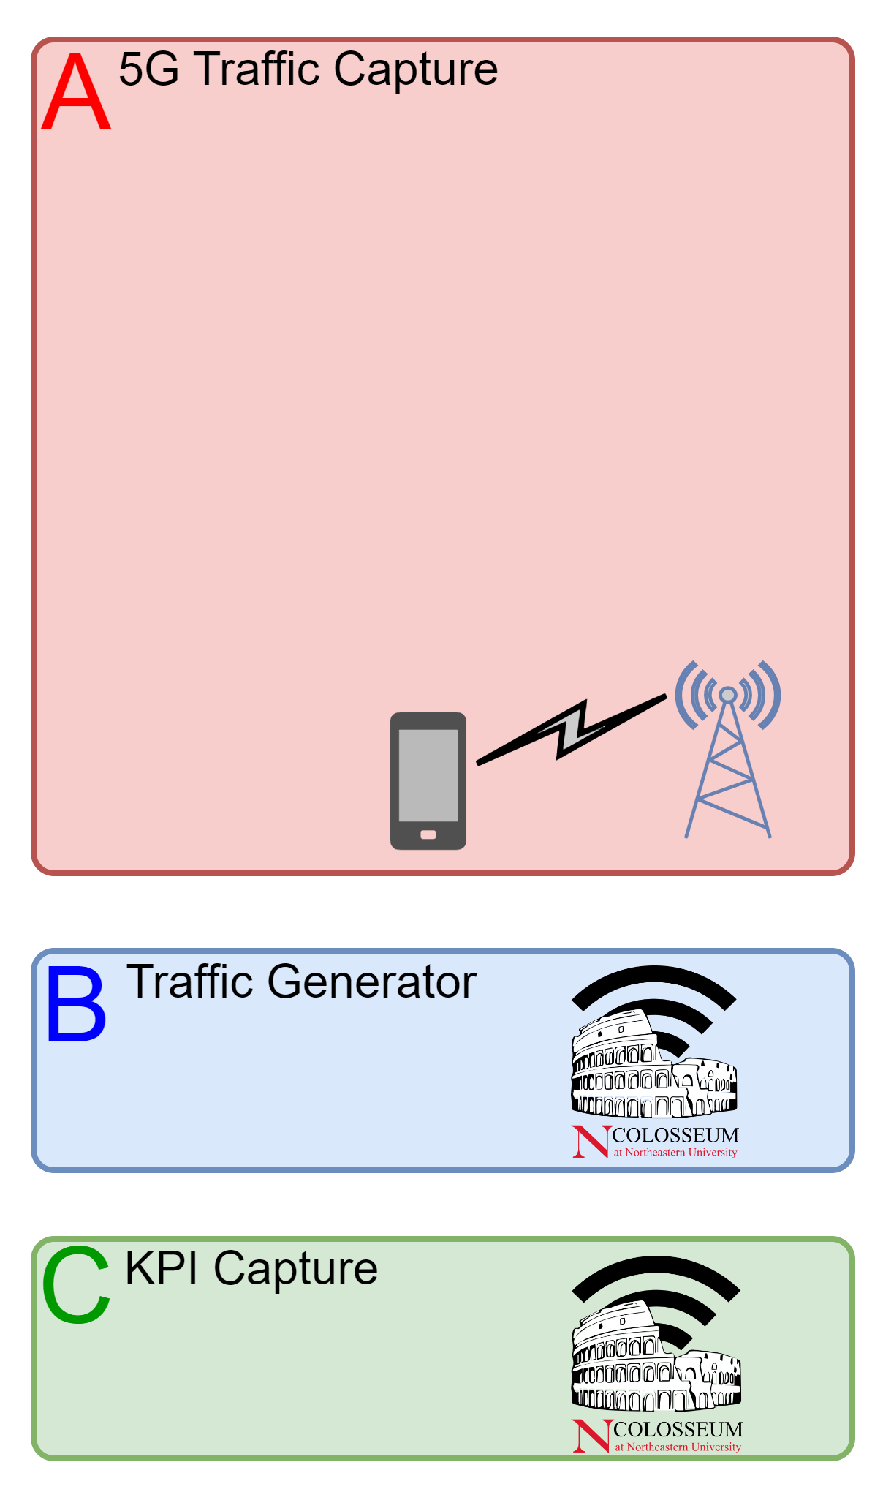
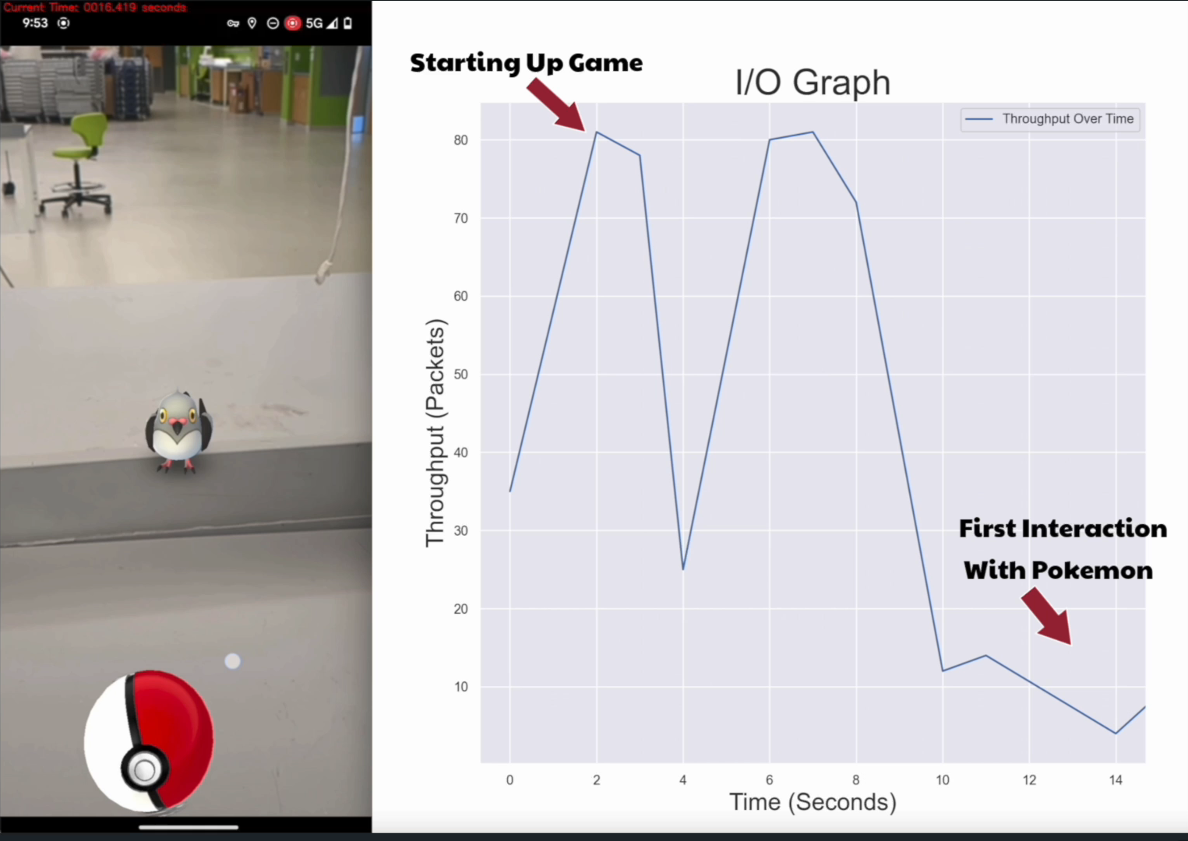




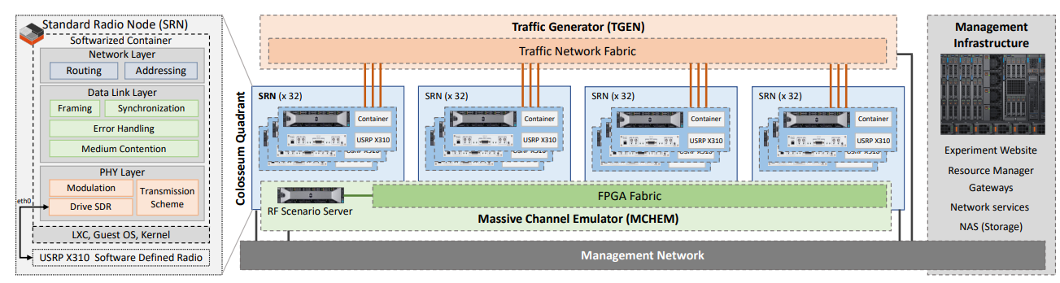
System
Data Collection and Emulation
Experimental Scenario
O-RAN environment
[1]
IMPACT
MCS
RAN Control
Power
RAN Control
Background UEs – x7
E2 RAN Control
Extensions
Slice Assignment
RAN Control
IMPACT xAPP
Automation
Scripts
E2 Interface
Key Performance
Metrics
PRB
RAN Control
Scheduler
RAN Control
UE
SCOPE
[3]
Interferer
gNB
[2]
[1] J. Groen, M. Belgiovine, U. Demir, B. Kim, and K. Chowdhury, “TRACTOR: Traffic Analysis and Classification Tool For Open RAN,” IEEE International Conference on Communications (ICC), June 2024.
[3] L. Bonati, et al., “Colosseum: Large-Scale Wireless Experimentation Through Hardware-in-the-Loop Network Emulation,” in Proceedings of IEEE Intl. Symp. on Dynamic Spectrum Access Networks (DySPAN), Virtual Conference, December 2021.
[2] Leonardo Bonati, Salvatore D'Oro, Stefano Basagni, and Tommaso Melodia,”SCOPE: an open and softwarized prototyping platform for NextG systems,” International Conference on Mobile Systems, Applications, and Services (MobiSys) 2021.
Notes:
We use a variety of applications to generate traffic for each network slice.
Next, we built a traffic generator tool to replay the traffic between the UE and gNB.
Our O-RAN test bed, built in Colosseum on top of the srsRAN and SCOPE frameworks, emulates the channel conditions between the gNB and UE based on measured channel conditions for a real deployed cellular system.
We also have the ability to add interference using different waveforms.
For demonstration purposes we use up to 8 UEs. All the UEs replay real 5G traffic as described earlier. For this talk we focus on one UE as it transitions between different traffic types with and without interference.
Interference is generated using a low frequency square wave shifted to the center UL or DL frequency band

Slide 11
Control Actions
Slice Assignment | Scheduling† | RB Allocation† Default / Interference | Power Default / Interference | MCS Default / Interference
[0] MMTC / CNTRL | [0] Round Robin | 9 / 6 | Medium | [2] Medium / [1] Low
[1] URLLC | [1] Water filling | 15 / 21 | Medium / High | [3] High / [0] Default
[2] eMBB | [2] Proportionally Fair | 26 / 23 | Medium / High | [3] High / [0] Default
This is just an example of the RAN functions that can be optimized based on both the traffic class and channel conditions through the near-RT RIC
† Provided by SCOPE.
Notes:
Water filling initially assigns all users 3 RB, then iteratively assigns 3 more RBs to each user with need until all RBs are exhausted. A user that needs RB should always get some.
Proportionally fair calculates each users needed RB and divides that users’ need over the sum of all users. It then rounds to the nearest integer, mod3 and assigns that number of RBs to each user. This means a user could have demand for RB, but get none.
RB allocation out of 50 RBs per time slot.
Power: Medium is 20dB gain, high is 60dB gain
MCS: [0] default adaptative modulation, [1] QPSK, [2] 16 QAM, [3] 64QAM – in all cases the coding scheme still uses the default adaptive mechanism

Slide 12
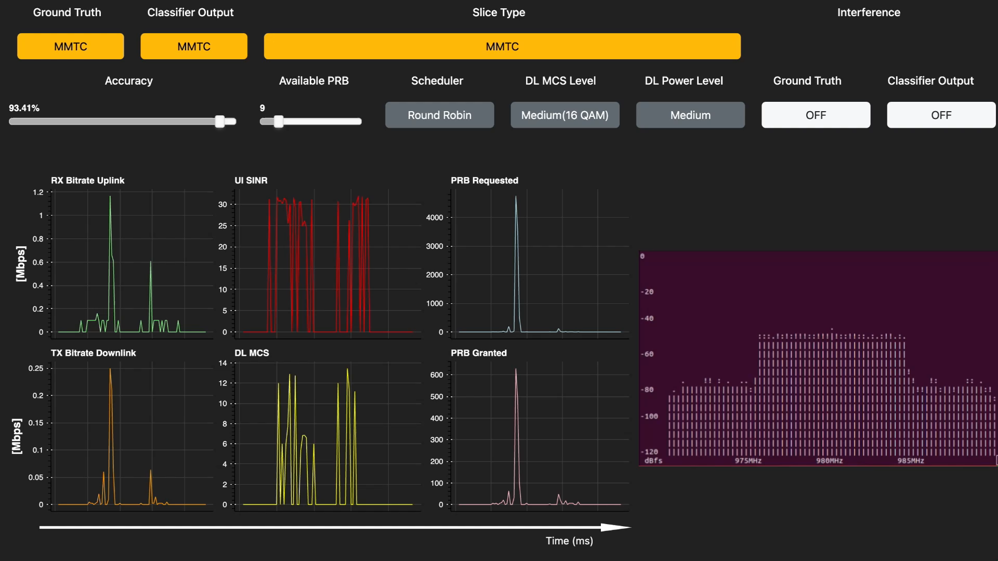
IMPACT xApp in Action
12
Notes:
In this trace we start with MMTC traffic. You can see our classifier is achieving above 90% accuracy. You can also observe the very bursty nature of the traffic.
After some time, the traffic switches to URLLC. Within 4 seconds, IMPACT correctly updates the classification to URLLC.
You can observe the increase in MCS, PRBs and throughput.

Slide 13
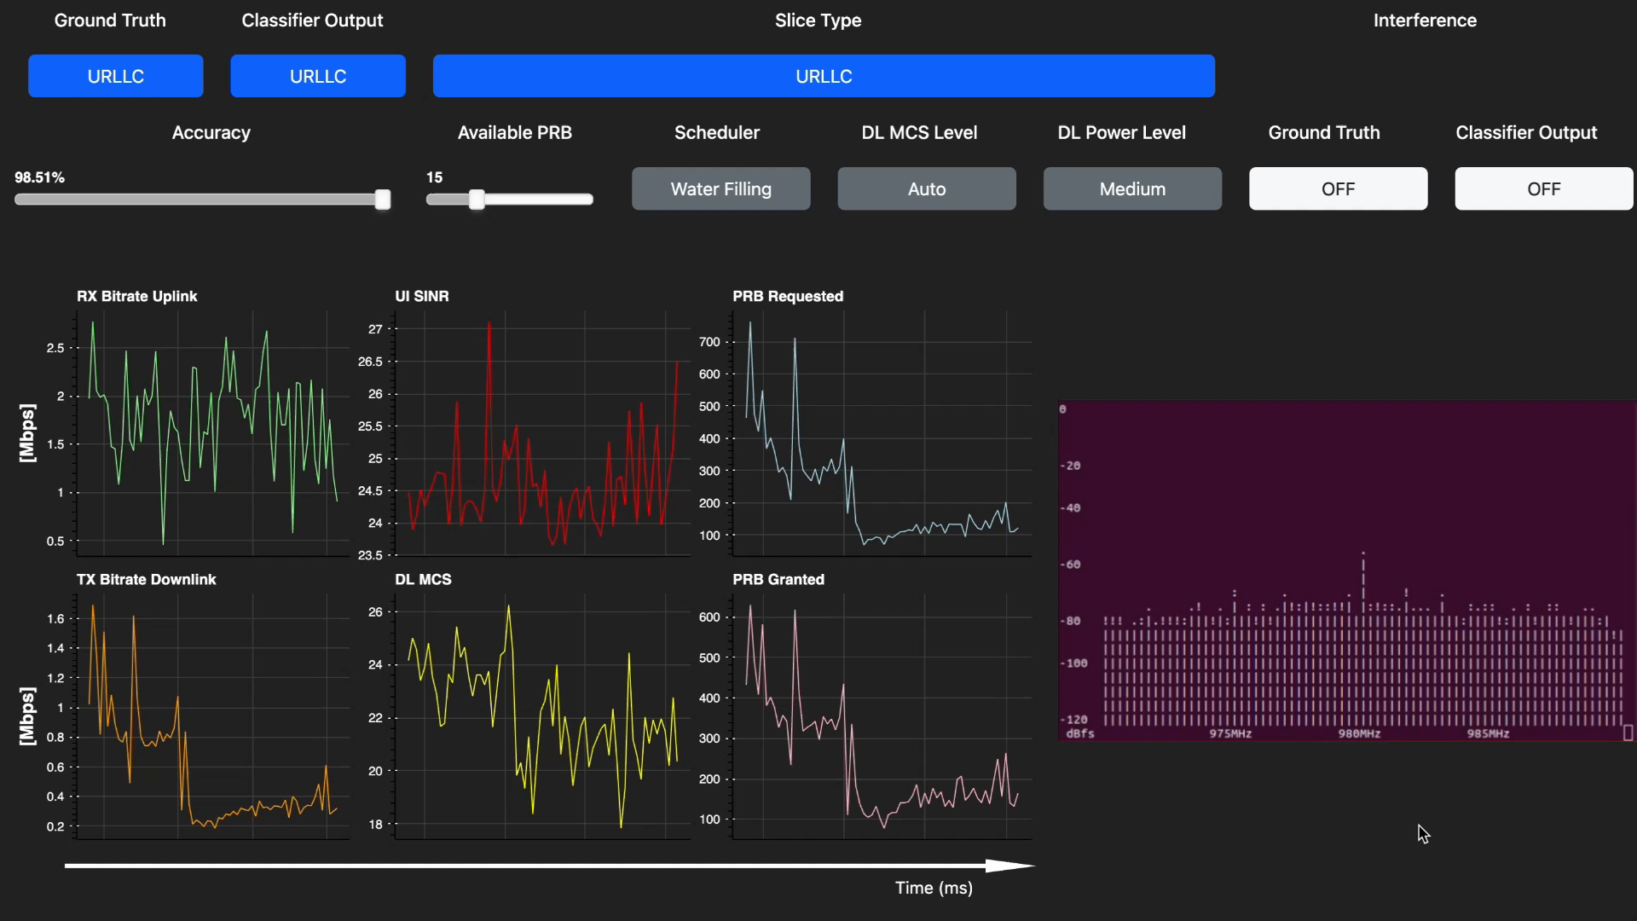
IMPACT xApp in Action
13
Notes:
In this trace, we start with URLLC traffic. After some time we switch to MMTC.
The classifier detects this transition even faster, and maintains accuracy above 95% the entire time.

Slide 14
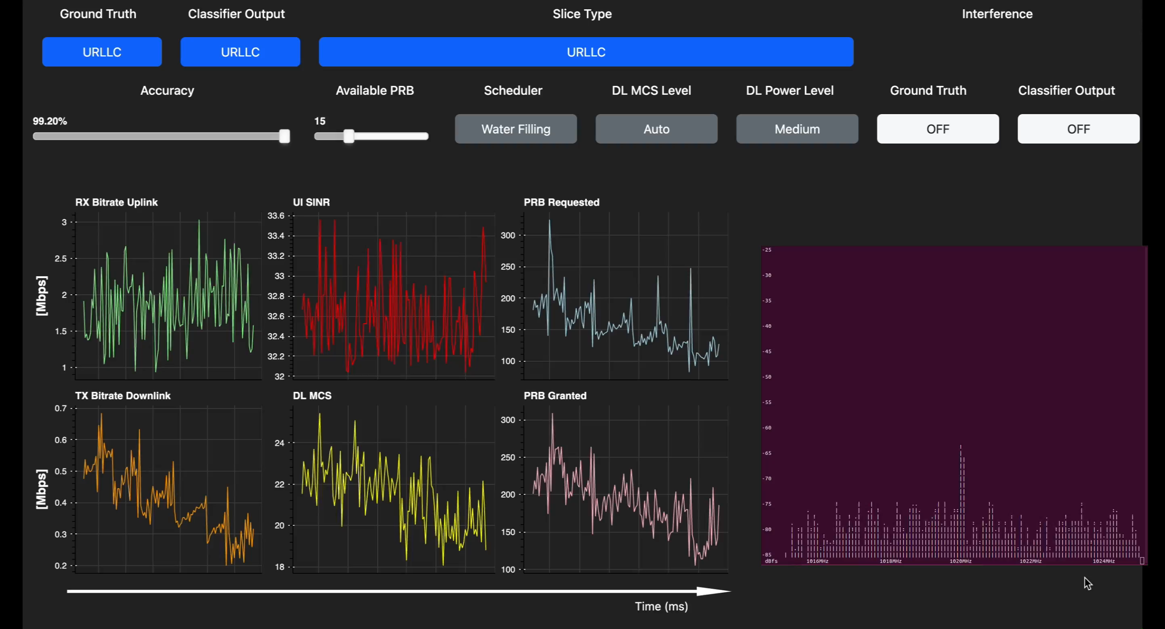
IMPACT xApp in Action
14
Notes:
In the presence of interference on the URLLC slice, IMPACT increases the number of resource blocks assigned, increases the power, and decreases the MCS – effectively maintaining the same service level despite the interference.

Slide 15
Conclusion
IMPACT xApp enables:
Up to 89% accuracy on traffic classification, the first step for traffic steering
Up to 99.6% accuracy on interference classification for URLLC traffic
Up to 7x energy savings for URLLC traffic
Up to 23x energy savings across all traffic types, based on channel conditions
Accuracy of IMPACT ML Models
for demonstrated transition tests
Transition Test | Traffic Accuracy | Interference Accuracy
MMTC – URLLC | 88.9% | 77.5%
URLLC – MMTC | 79.6% | 79.3%
Int. OFF – ON for URLLC | 79.2% | 99.6%
Notes:
When URLLC traffic experiences interference, IMPACT uses LOWER MCS and MORE PRBs to provide similar throughput and 9 times lower average queue length than the baseline configuration. When there is NO interference, IMPACT reduces transmission gain by 40dB using 7 times less power during the test scenario than the baseline.

Slide 16
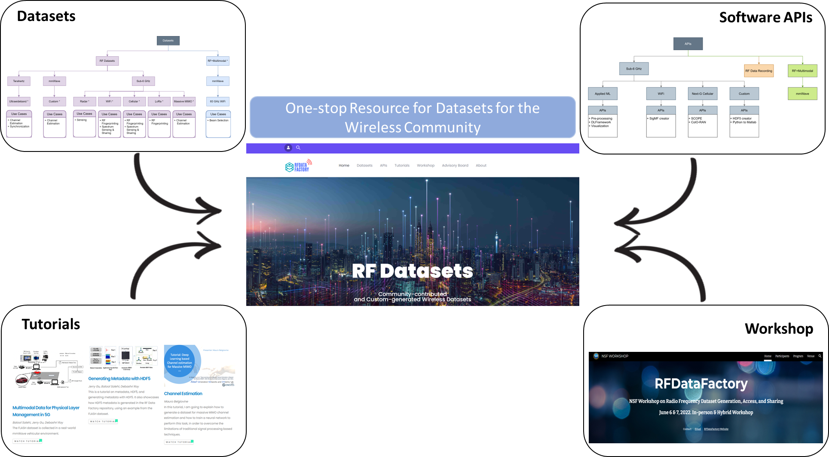
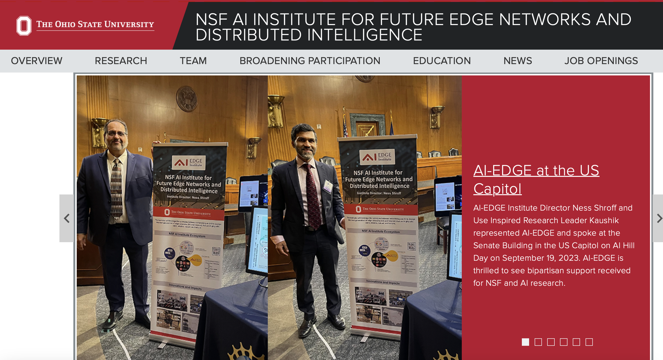
Exploiting Expertise and Collaborations (Beyond NEU and GMU)
NSF RFDataFactory
https://www.rfdatafactory.com
NSF AI Edge Institute
https://aiedge.osu.edu

Slide 17
Q&A

